Slide 1

Bluetooth Low Energy

Slide 2
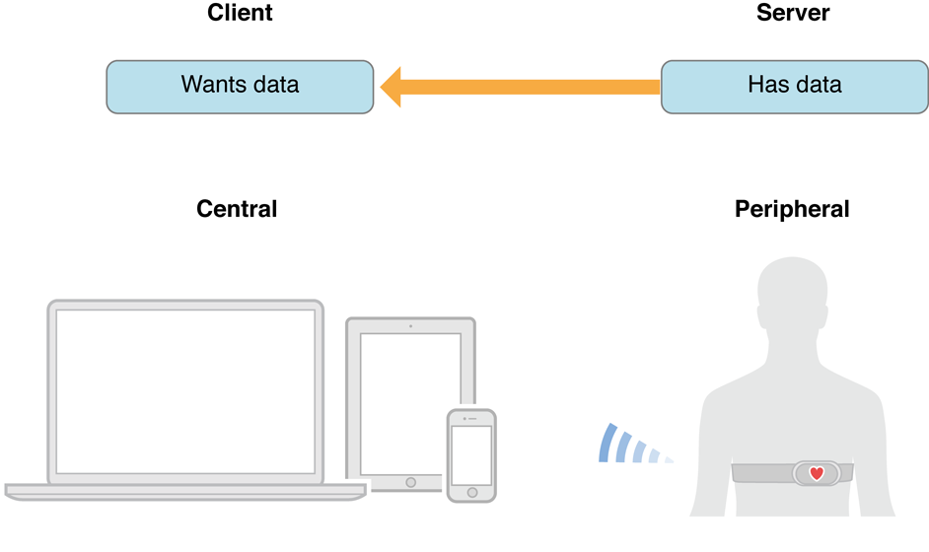
Overall View
iPhone
Edison

Slide 3
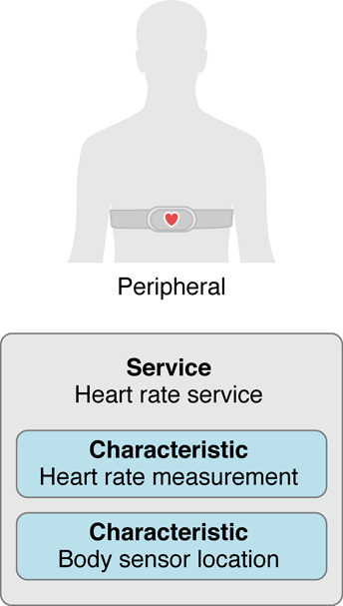
Services and characteristics
A service is basically a collection of data. For example, a heart rate monitor may have a service of exposing heart rate data from the monitor’s heart rate sensor
Services are made up of characteristics. For example, the heart rate service described above may have a characteristic that tells the intended body location of the device’s heart rate sensor.
Another characteristic is transmitting the heart rate measurement data.
Note: The central can also interact with the peripheral by reading or writing a specific service’s characteristic.

Slide 4
How everything relates to this project
The Edison will be the peripheral.
The iPhone will be the central.
The Edison will have a service, for example “Fatigue” service
iPhone will request data from the Edison (This happens when the user taps “Ready” button”.
Edison will then advertise the data.
iPhone will display data from Edison on the screen.

Slide 5
Bluetooth on the Edison
Uses BlueZ, the official Linux protocol stack
“Plugins” implement features and profiles
Initializes application layer on startup
Runs scripts when adapter is registered and when a device is paired
There are to plugins support the pre-existing profiles
Custom plugins may also be used
“Profiles” specify general communication behaviors
SHAF can adapt a pre-existing profile, or
Create a custom profile

Slide 6
Important First Tasks for Bluetooth
Pair an iPhone with an Edison
Decide if a pre-existing profile can be used
Otherwise, decide functionality of custom profile
Communicate some data from Edison to Bluetooth via chosen profile

Slide 7
Sources
Bluetooth for Developers. Digital image. Apple. N.p., n.d. Web.
Intel Edison Bluetooth Guide. June 2015, Revision 007
www.apple.com

